Slide 1
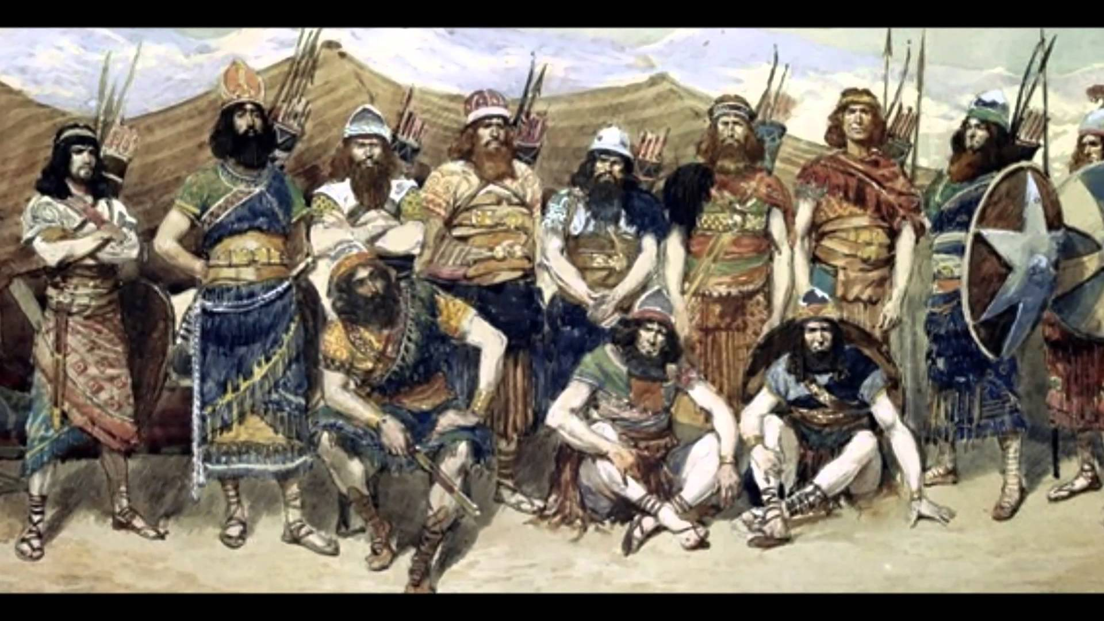
David the Deliverer
1 Samuel 23

Slide 2
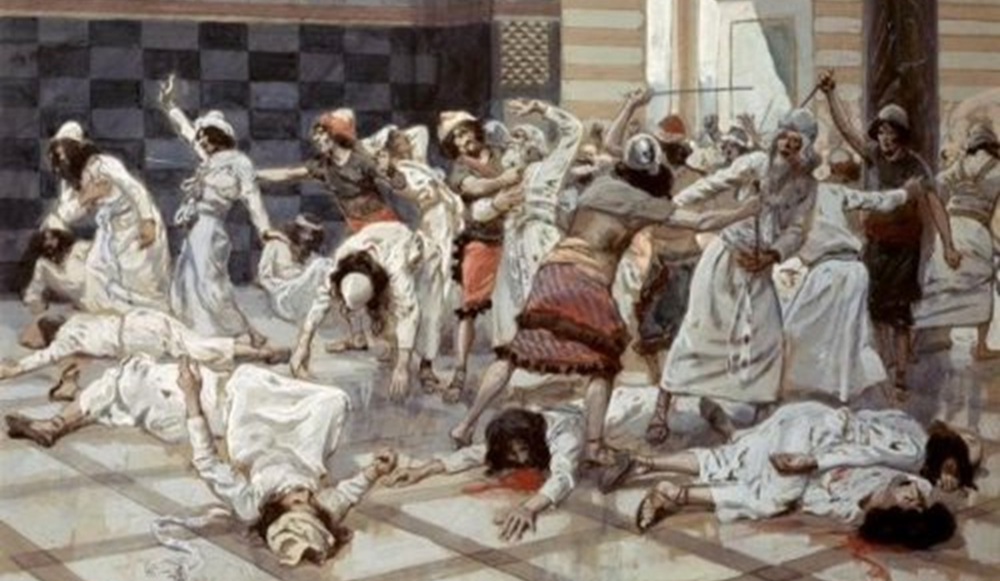

Slide 3
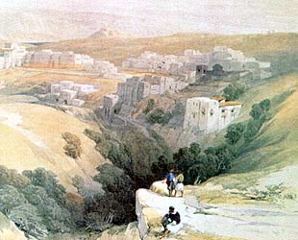
The thief comes to steal.
When God’s people flourish, the enemy works to ensure their loss.
The Israelis did the hard work of harvesting the grain.
The Philistines ate it.
Keilah’s protection was Saul’s job.

Slide 4
1 Samuel 8:19-20 Nevertheless the people refused to obey the voice of Samuel; and they said, Nay; but we will have a king over us; 20 That we also may be like all the nations; and that our king may judge us, and go out before us, and fight our battles.

Slide 5
Saul was spending up all the time and resources hunting David.

Slide 6

Faith is the victory that overcomes the world.
They were afraid of the potential danger: caught between the armies of the Philistines and Saul.
Once we’ve heard from the Lord, that should settle it.
David’s courage, submission to and faith in God saved Keilah!

Slide 7
2 Timothy 1:7 For God hath not given us the spirit of fear; but of power, and of love, and of a sound mind.
Isaiah 41:10 Fear thou not; for I am with thee: be not dismayed; for I am thy God: I will strengthen thee; yea, I will help thee; yea, I will uphold thee with the right hand of my righteousness.

Slide 8

Escape to the wilderness.
Proverbs 11:14 Where no counsel is,
the people fall: but in the multitude of
counsellors there is safety.
Isaiah 5:20 Woe unto them that call evil good, and good evil; that put darkness for light, and light for darkness; that put bitter for sweet, and sweet for bitter!
Picture: Death burial and resurrection!
David has now an access to God’s directive will that Saul does not. Abiathar brought the Ephod when he escaped from the slaughter of Nob.

Slide 9
Escape to the wilderness.
Trouble? Stop and seek the Lord.
  He will come down
  They will deliver you up
  (1Sam 23:12)
Both predictions were based on David's remaining in Keilah.
God did not lie.
Notice: God’s deliverance comes thru prayer!

Slide 10
Matthew 7:7 Ask, and it shall be given you; seek, and ye shall find; knock, and it shall be opened unto you:
Philippians 4:6-7 6 Be careful for nothing; but in every thing by prayer and supplication with thanksgiving let your requests be made known unto God. 7 And the peace of God, which passeth all understanding, shall keep your hearts and minds through Christ Jesus.

Slide 11
Growing leaders: from time to time, the people you sacrifice for will turn on you.

Slide 12
Psalm 41:9 Yea, mine own familiar friend, in whom I trusted, which did eat of my bread, hath lifted up his heel against me.

Slide 13
God made sure that the trial came with encouragement.

Slide 14
John 13:14 If I then, your Lord and Master, have washed your feet; ye also ought to wash one another's feet.
Galatians 6:10 As we have therefore opportunity, let us do good unto all men, especially unto them who are of the household of faith.

Slide 15
Jonathan’s encouragement for us?
THE KING WILL RULE and we will be “next unto” Him.

Slide 16
Revelation 22:5 And there shall be no night there; and they need no candle, neither light of the sun; for the Lord God giveth them light: and they shall reign for ever and ever.
Romans 8:16-18 The Spirit itself beareth witness with our spirit, that we are the children of God: 17 And if children, then heirs; heirs of God, and joint-heirs with Christ; if so be that we suffer with him, that we may be also glorified together. 18 For I reckon that the sufferings of this present time are not worthy to be compared with the glory which shall be revealed in us.

Slide 17
Psalm 37:23 The steps of a good man are ordered by the LORD: and he delighteth in his way.

Slide 18
Psalm 54:1-7 1 A Psalm of David, when the Ziphims came and said to Saul, Doth not David hide himself with us?
Save me, O God, by thy name, and judge me by thy strength. 2 Hear my prayer, O God; give ear to the words of my mouth. 3 For strangers are risen up against me, and oppressors seek after my soul: they have not set God before them. Selah. 4 Behold, God is mine helper: the Lord is with them that uphold my soul. 5 He shall reward evil unto mine enemies: cut them off in thy truth. 6 I will freely sacrifice unto thee: I will praise thy name, O LORD; for it is good. 7 For he hath delivered me out of all trouble: and mine eye hath seen his desire upon mine enemies.

Slide 19
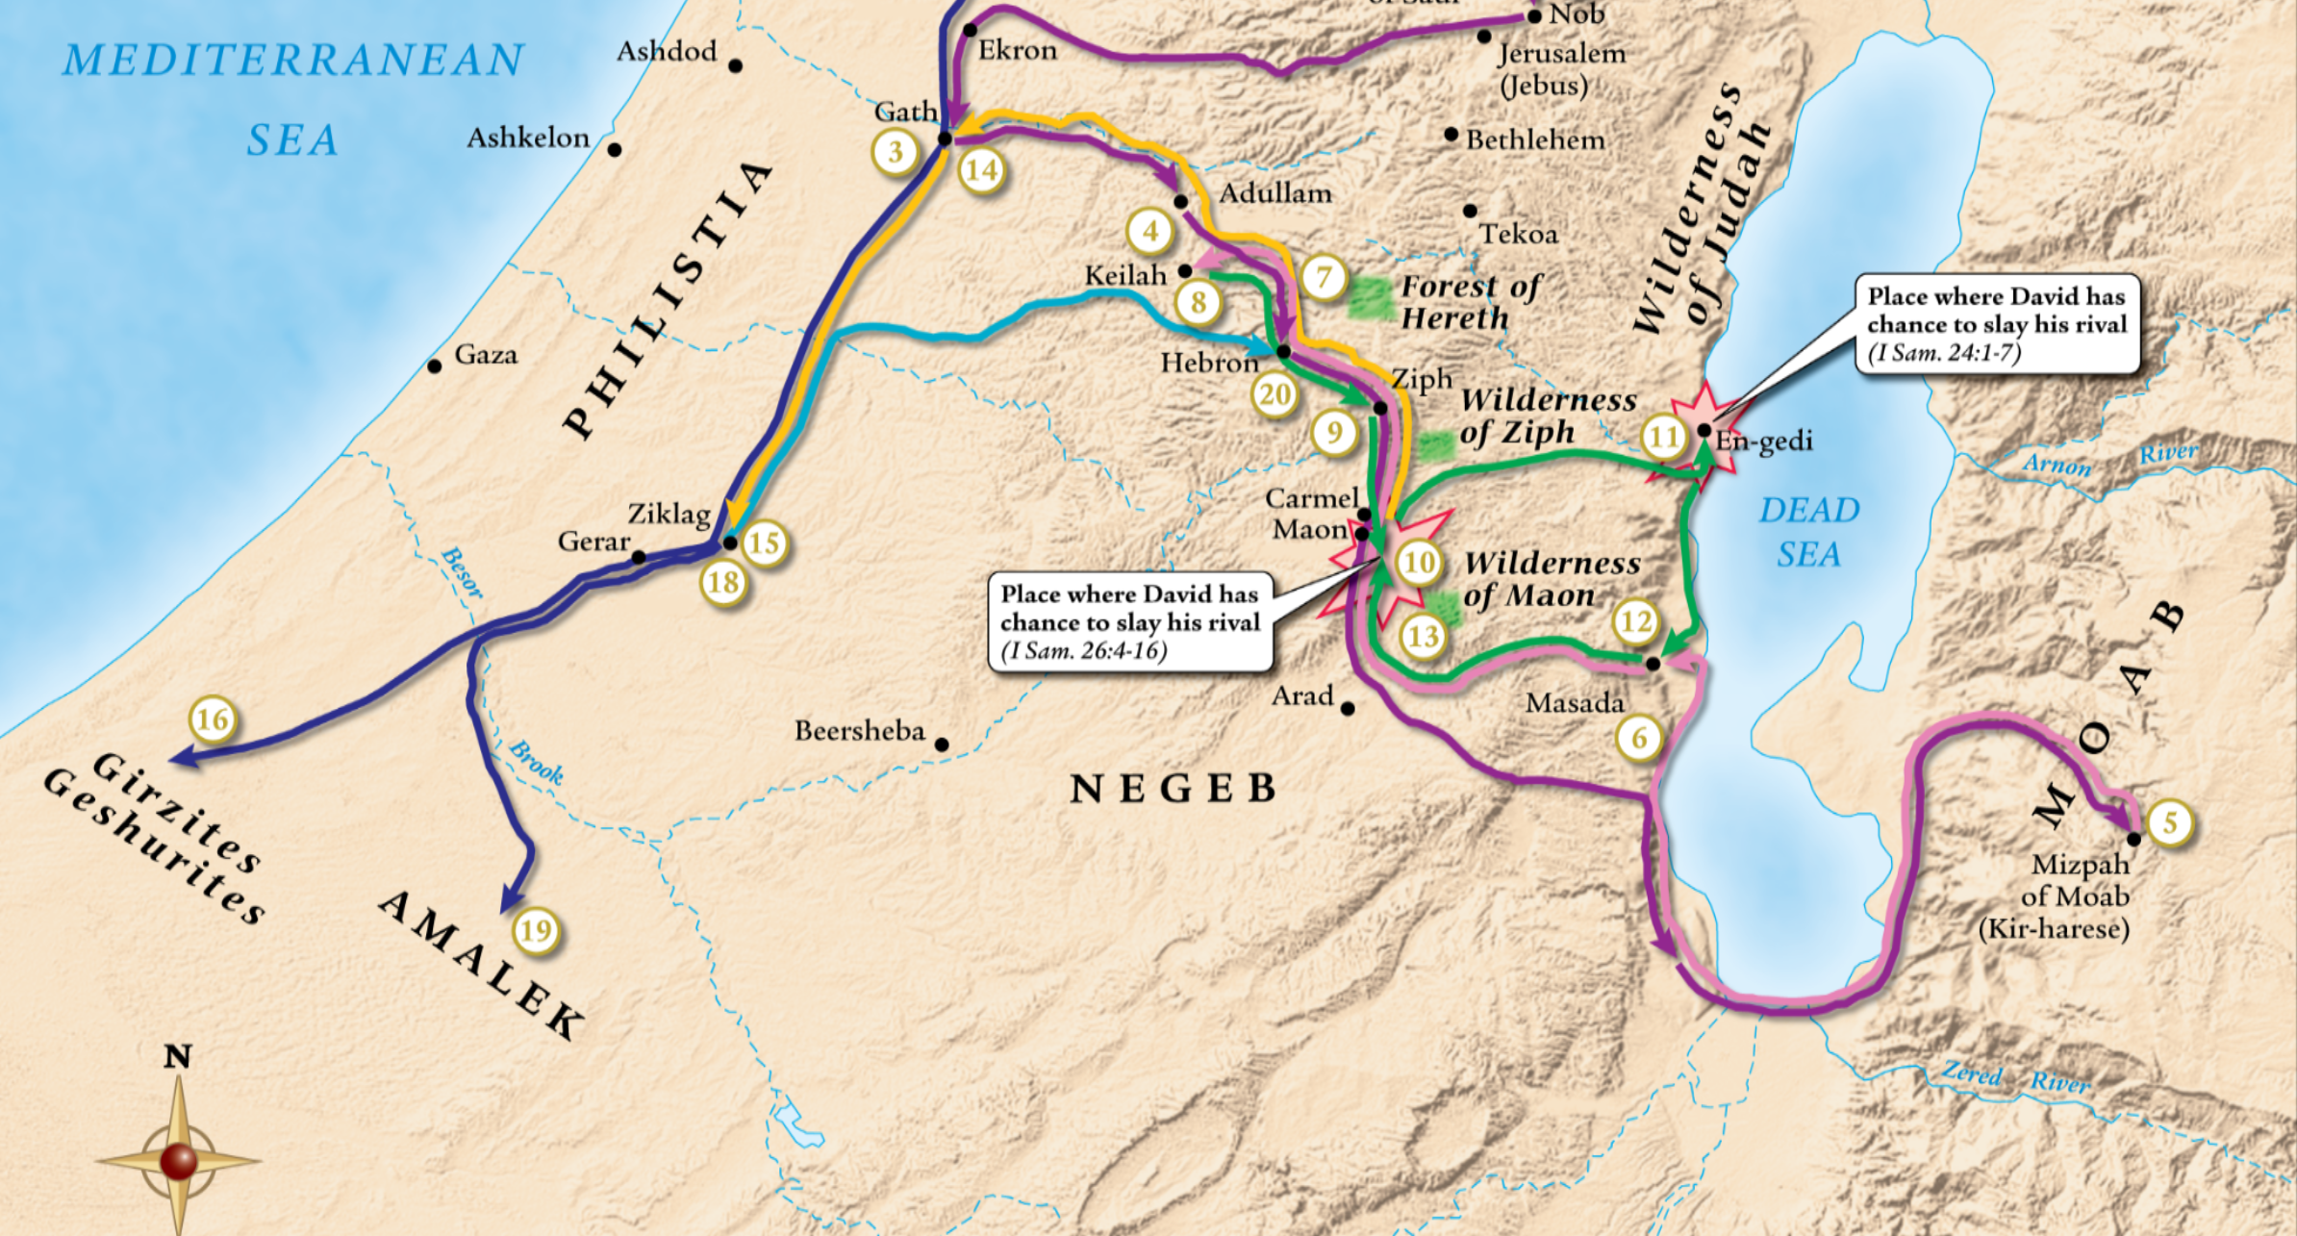

Slide 20
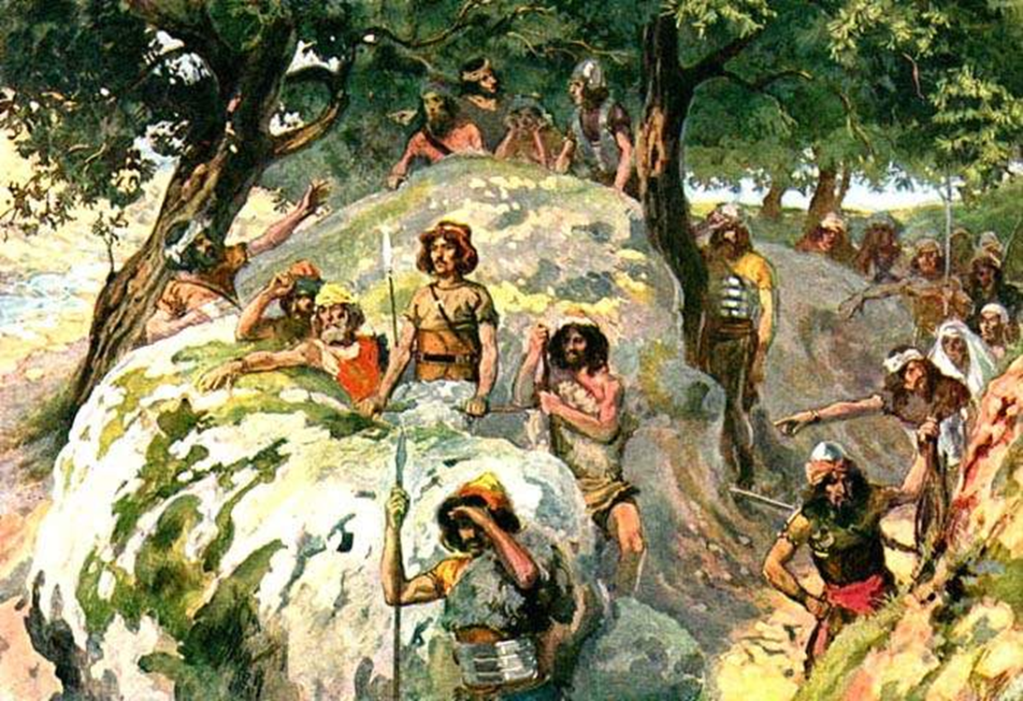
Move forward in faith.
Saul was not foremost
David’s enemy, he was
God’s enemy.
What should have been
certain destruction thru
a pincher tactic – God
intervened.
In the attack: God made
a way of escape.
David could bear it!

Slide 21
1 Corinthians 10:13 There hath no temptation taken you but such as is common to man: but God is faithful, who will not suffer you to be tempted above that ye are able; but will with the temptation also make a way to escape, that ye may be able to bear it.

Slide 22
Exodus 14:14 The LORD shall fight for you, and ye shall hold your peace.
Zechariah 2:4-5 4 And said unto him, Run, speak to this young man, saying, Jerusalem shall be inhabited as towns without walls for the multitude of men and cattle therein: 5 For I, saith the LORD, will be unto her a wall of fire round about, and will be the glory in the midst of her.

Slide 23
Hebrews 13:5-6 5 Let your conversation be without covetousness; and be content with such things as ye have: for he hath said, I will never leave thee, nor forsake thee. 6 So that we may boldly say, The Lord is my helper, and I will not fear what man shall do unto me.
Psalm 28:7 The LORD is my strength and my shield; my heart trusted in him, and I am helped: therefore my heart greatly rejoiceth; and with my song will I praise him.

Slide 24
David was in a world of hurt.
How did God strengthen him?
God answered
David’s prayer.
God gave brethren
to encourage him.
God moved for
David’s sake.

Slide 25


Slide 26
David the Deliverer
1 Samuel 23

